Slide 1
Hybrid recommendation approaches

Slide 2



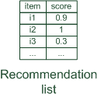
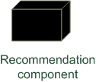



Hybrid recommender systems
Hybrid: combinations of various inputs and/or composition of different mechanism
Collaborative: "Tell me what's popular among my peers"
Content-based: "Show me more of the same what I've liked"
Knowledge-based: "Tell me what fits based on my needs"

Slide 3
Hybrid recommender systems
All three base techniques are naturally incorporated by a good sales assistant (at different stages of the sales act) but have their shortcomings
For instance, cold start problems
Idea of crossing two (or more) species/implementations
hybrida [lat.]: denotes an object made by combining two different elements
Avoid some of the shortcomings
Reach desirable properties not (or only inconsistently) present in parent individuals
Different hybridization designs
Parallel use of several systems
Monolithic exploiting different features
Pipelined invocation of different systems

Slide 4
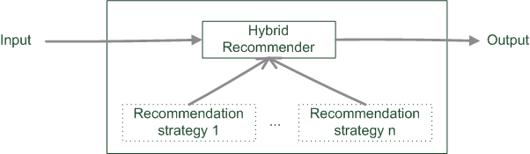
Monolithic hybridization design
Only a single recommendation component
Hybridization is "virtual" in the sense that
Features/knowledge sources of different paradigms are combined

Slide 5
Monolithic hybridization designs: Feature combination
Combination of several knowledge sources
E.g.: Ratings and user demographics or explicit requirements and needs used for similarity computation
"Hybrid" content features:
Social features: Movies liked by user
Content features: Comedies liked by user, dramas liked by user
Hybrid features: user likes many movies that are comedies, …
“the common knowledge engineering effort that involves inventing good features to enable successful learning” [Chumki Basuet al. 1998]

Slide 6
Monolithic hybridization designs: Feature augmentation
Content-boosted collaborative filtering [Prem Melville et al. 2002]
Based on content features additional ratings are created
E.g. Alice likes Items 1 and 3 (unary ratings)
Item7 is similar to 1 and 3 by a degree of 0.75
Thus Alice likes Item7 by 0.75
Item matrices become less sparse
Significance weighting and adjustment factors
Peers with more co-rated items are more important
Higher confidence in content-based prediction, if higher number of own ratings
Recommendation of research papers [Roberto Torres et al. 2004]
Citations interpreted as collaborative recommendations

Slide 7
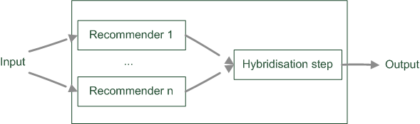
Parallelized hybridization design
Output of several existing implementations combined
Least invasive design
Some weighting or voting scheme
Weights can be learned dynamically
Extreme case of dynamic weighting is switching

Slide 8

Parallelized hybridization design: Weighted
Compute weighted sum:
Recommender 1
Item1 | 0.5 | 1
Item2 | 0
Item3 | 0.3 | 2
Item4 | 0.1 | 3
Item5 | 0
Recommender 2
Item1 | 0.8 | 2
Item2 | 0.9 | 1
Item3 | 0.4 | 3
Item4 | 0
Item5 | 0
Recommender weighted(0.5:0.5)
Item1 | 0.65 | 1
Item2 | 0.45 | 2
Item3 | 0.35 | 3
Item4 | 0.05 | 4
Item5 | 0.00

Slide 9
Parallelized hybridization design: Weighted
BUT, how to derive weights?
Estimate, e.g. by empirical bootstrapping
Dynamic adjustment of weights
Empirical bootstrapping
Historic data is needed
Compute different weightings
Decide which one does best
Dynamic adjustment of weights
Start with for instance uniform weight distribution
For each user adapt weights to minimize error of prediction

Slide 10
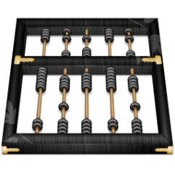
Parallelized hybridization design: Weighted
Let's assume Alice actually bought/clicked on items 1 and 4
Identify weighting that minimizes Mean Absolute Error (MAE)
Absolute errors and MAE
Beta1 | Beta2 |  | rec1 | rec2 | error | MAE
0.1 | 0.9 | Item1 | 0.5 | 0.8 | 0.23 | 0.61
 |  | Item4 | 0.1 | 0.0 | 0.99
0.3 | 0.7 | Item1 | 0.5 | 0.8 | 0.29 | 0.63
 |  | Item4 | 0.1 | 0.0 | 0.97
0.5 | 0.5 | Item1 | 0.5 | 0.8 | 0.35 | 0.65
 |  | Item4 | 0.1 | 0.0 | 0.95
0.7 | 0.3 | Item1 | 0.5 | 0.8 | 0.41 | 0.67
 |  | Item4 | 0.1 | 0.0 | 0.93
0.9 | 0.1 | Item1 | 0.5 | 0.8 | 0.47 | 0.69
 |  | Item4 | 0.1 | 0.0 | 0.91
MAE improves as rec2 is weighted more strongly

Slide 11
Parallelized hybridization design: Weighted
BUT: didn't rec1 actually rank Items 1 and 4 higher?
Be careful when weighting!
Recommenders need to assign comparable scores over all users and items
Some score transformation could be necessary
Stable weights require several user ratings
Recommender 1
Item1 | 0.5 | 1
Item2 | 0
Item3 | 0.3 | 2
Item4 | 0.1 | 3
Item5 | 0
Recommender 2
Item1 | 0.8 | 2
Item2 | 0.9 | 1
Item3 | 0.4 | 3
Item4 | 0
Item5 | 0

Slide 12
Parallelized hybridization design: Switching
Requires an oracle that decides on recommender
Special case of dynamic weights (all except one Beta is 0)
Example:
Ordering on recommenders and switch based on some quality criteria
E.g. if too few ratings in the system use knowledge-based, else collaborative
More complex conditions based on contextual parameters, apply classification techniques

Slide 13

Parallelized hybridization design: Mixed
Combines the results of different recommender systems at the level of user interface
Results of different techniques are presented together
Recommendation result for user $u$ and item $i$ is the set of tuples $<score,k>$ for each of its $n$ constituting recommenders ${rec}_{k}$

Slide 14
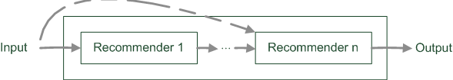
Pipelined hybridization designs
One recommender system pre-processes some input for the subsequent one
Cascade
Meta-level
Refinement of recommendation lists (cascade)
Learning of model (e.g. collaborative knowledge-based meta-level)

Slide 15
Pipelined hybridization designs: Cascade
Successor's recommendations are restricted by predecessor
Where forall k > 1
Subsequent recommender may not introduce additional items
Thus produces very precise results

Slide 16
Pipelined hybridization designs: Cascade
Recommendation list is continually reduced
First recommender excludes items
Remove absolute no-go items (e.g. knowledge-based)
Second recommender assigns score
Ordering and refinement (e.g. collaborative)

Slide 17
Pipelined hybridization designs: Cascade
Recommender 1
Item1 | 0.5 | 1
Item2 | 0
Item3 | 0.3 | 2
Item4 | 0.1 | 3
Item5 | 0
Recommender 2
Item1 | 0.8 | 2
Item2 | 0.9 | 1
Item3 | 0.4 | 3
Item4 | 0
Item5 | 0
Removing no-go items
Ordering and refinement
Recommender 3
Item1 | 0.80 | 1
Item2 | 0.00
Item3 | 0.40 | 2
Item4 | 0.00
Item5 | 0.00

Slide 18
Pipelined hybridization designs: Meta-level
Successor exploits a model delta built by predecessor
Examples:
Fab:
Online news domain
CB recommender builds user models based on weighted term vectors
CF identifies similar peers based on these user models but makes recommendations based on ratings
Collaborative constraint-based meta-level RS
Collaborative filtering learns a constraint base
Knowledge-based RS computes recommendations

Slide 19
Limitations of hybridization strategies
Only few works that compare strategies from the meta-perspective
Like for instance, [Robin Burke 2002]
Most datasets do not allow to compare different recommendation paradigms
i.e. ratings, requirements, item features, domain knowledge, critiques rarely available in a single dataset
Thus few conclusions that are supported by empirical findings
Monolithic: some preprocessing effort traded-in for more knowledge included
Parallel: requires careful matching of scores from different predictors
Pipelined: works well for two antithetic approaches
Netflix competition – "stacking" recommender systems
Weighted design based on >100 predictors – recommendation functions
Adaptive switching of weights based on user model, context and meta-features

Slide 20
Literature
[Robin Burke 2002] Hybrid recommender systems: Survey and experiments, User Modeling and User-Adapted Interaction 12 (2002), no. 4, 331-370.
[Prem Melville et al. 2002] Content-Boosted Collaborative Filtering for Improved Recommendations, Proceedings of the 18th National Conference on Artificial Intelligence (AAAI) (Edmonton,CAN), American Association for Artificial Intelligence, 2002, pp. 187-192.
[Roberto Torres et al. 2004] Enhancing digital libraries with techlens, International Joint Conference on Digital Libraries (JCDL'04) (Tucson, AZ), 2004, pp. 228-236.
[Chumki Basuet al. 1998] Recommendation as classification: using social and content-based information in recommendation, In Proceedings of the 15th National Conference on Artificial Intelligence (AAAI'98) (Madison, Wisconsin, USA States), American Association for Artificial Intelligence, 1998, pp. 714-720.

